Slide 1
Exam Scores by Demographics
By: Jack Owen

Slide 2
Data and Background
Variables within the dataset:
Independent Variables:
Gender
Race/Ethnicity
Parents highest educational background
Lunch Accessibility
Test Preparation
Response Variables:
Score
Exam Type
This is a fictional dataset created by Royce Kimmons under his various statistical publications.
We find 5 variables that we can filter and analyze various exam scores on.
We can compare 3 types of exam scores against each other based off filtering
This can help us in visualizing potential trends between subgroups of students
Compare female students with different Race/Ethnic backgrounds
Test preparation of students on test scores

Slide 3
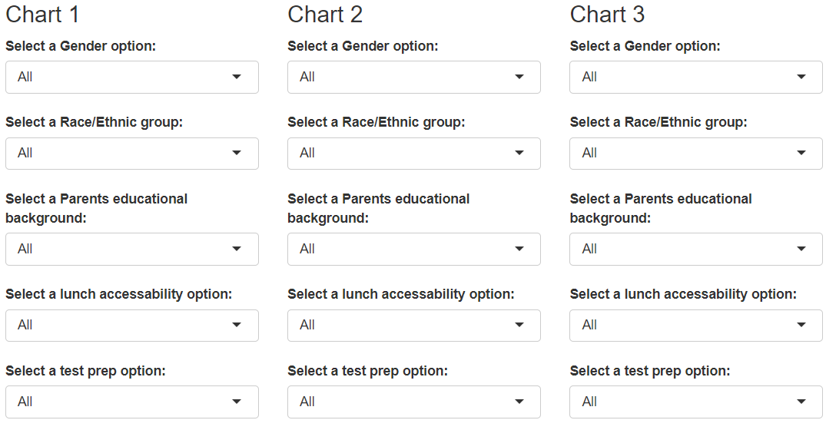
Shiny App
Can compare up to 3 bar charts that are filtered on 5 different parameters that will update their respective charts based on filter selection
Options include all unique values within each parameters vector within the original data frame.

Slide 4
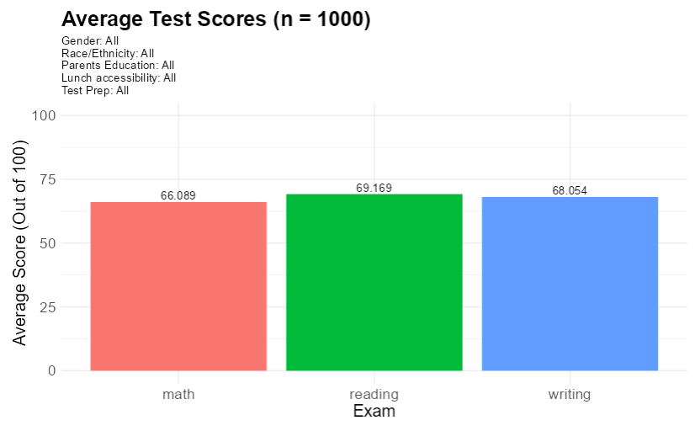
Shiny App
3 separate graphs are updated based on filters.
Includes the title for Average Test Scores and the size of students being measured based on filters.
Color coordinated exam types with average test scores for each filtered item.
Inclusion of labels for each filter selected for easier portrayal of chart.

Slide 5

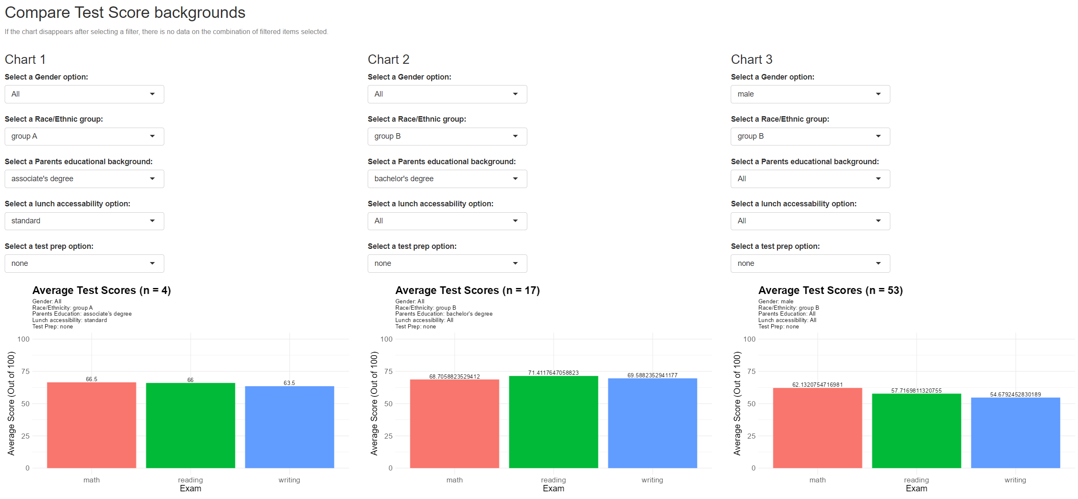
Overall View of Shiny App

Slide 6
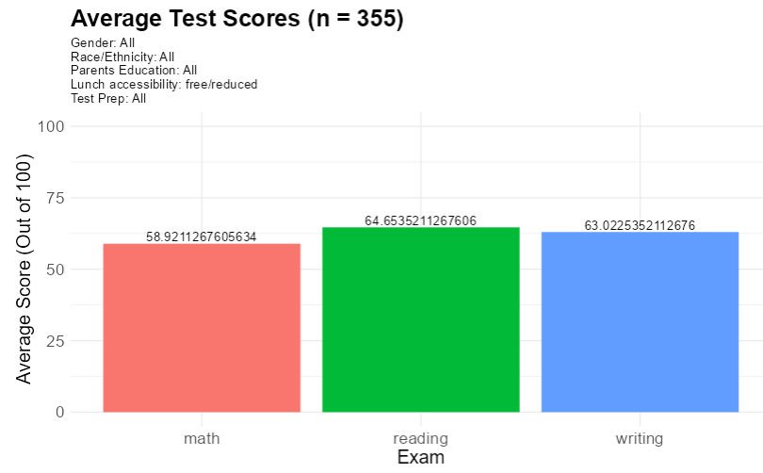
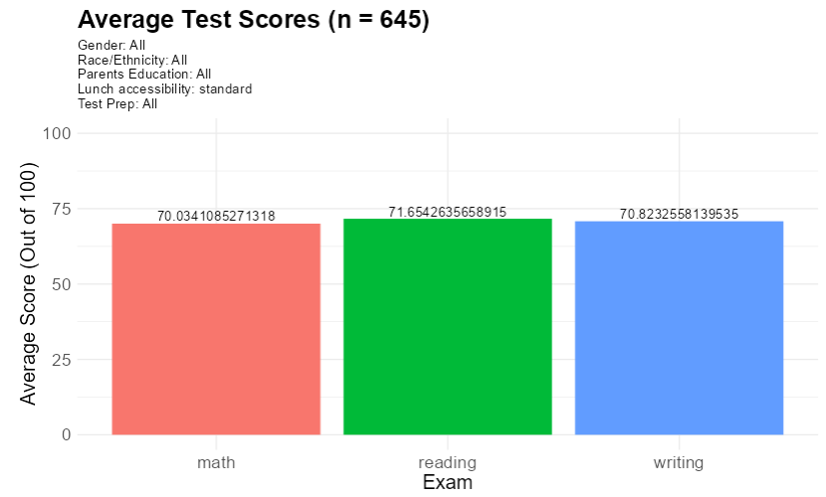
Data Visual 1
We compare lunch accessibility of ‘Free/Reduced’ vs. ‘Standard’ Lunch groups.
Test scores decrease overall when the student is on free/reduced lunch compared to standard.
This doesn’t mean those who eat free/reduced lunch are not as smart as those who don’t but may be a larger issue with poverty.
Those on lunch programs tend to have their basic needs met less often than those who aren’t as low income is often seen as a cause for lower education.
As a result of this, there may be reason to further investigate income of families against educational outcomes of those students.

Slide 7
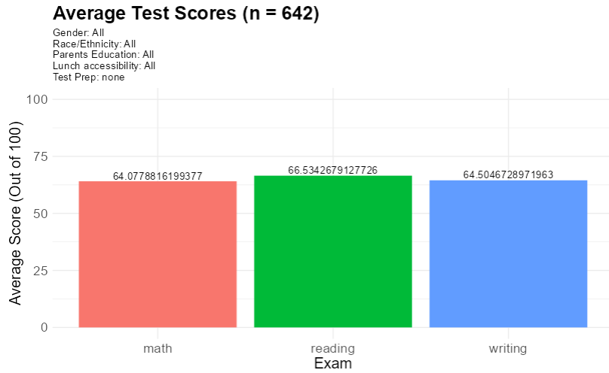
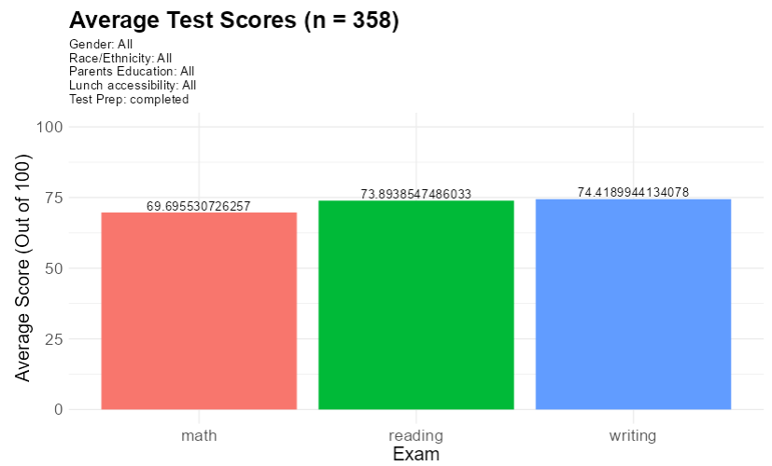
Data Visual 2
We compare Test Preparation vs. No Test Preparation among student's exam scores.
In our plots to the left, we find those who had test prep score higher overall on each exam compared to those who did not.
Similar to the mention of poverty on the previous slide, we could potentially attribute this test prep class to those who have the ability to pay for it, resulting in those in lower income brackets may score lower on exams.

Slide 8
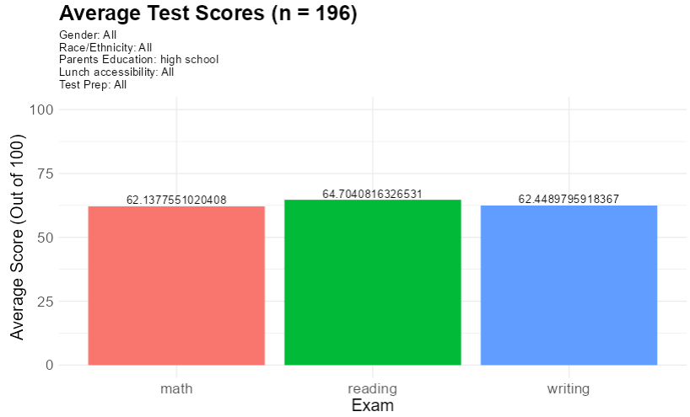
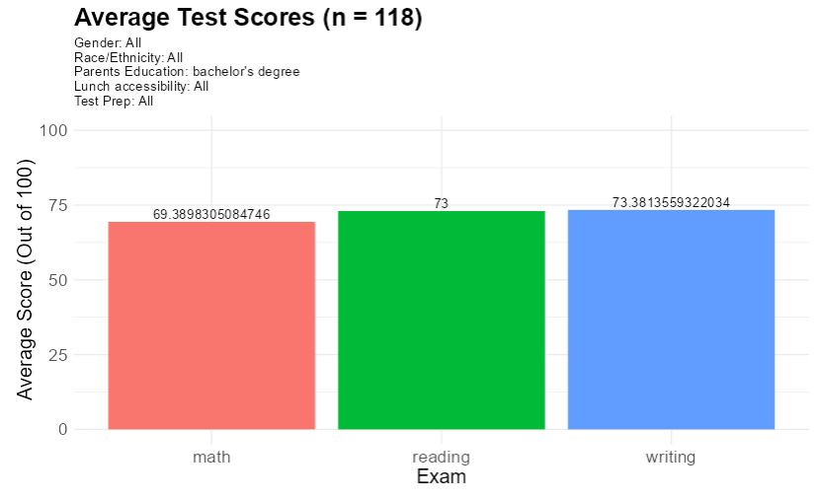
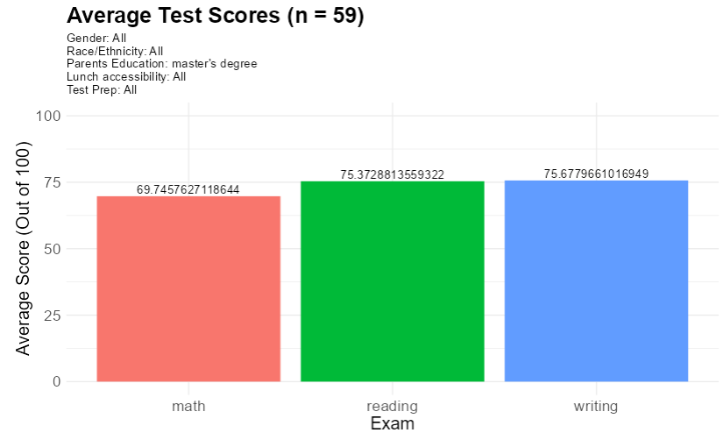
Data Visual 3
We compare the highest education parents of students have attained, High School vs. Bachelor’s vs. Master’s.
We find a large jump (7 to 11 points) between High School to Bachelor’s while not so large of a jump (0.5 to 2 points) between Bachelor’s and Master’s.
From this, we find that lower educated families often result in lower test scores for their children with a potentially exponential curve that flattens as a higher degree is attained by a student's parent.

Slide 9
Principles
Regarding my Shiny app, I believe I followed visualization principles of reduced chart junk and expressiveness principles
From the top, I indicate that a charts disappearance is a result of the filter combinations not being available.
I make a clear filter system of 5 items each above their respective chart to display data that is desired.
I find the displaying of the count of students from filters and the filters being done on each graph important as it shows the representation we are looking at as well as the inclusion of filters in the event we would like to screenshot our visual.
The coloring of each exam type draws attention to how large each graph is instead of only seeing a black/gray block on your screen that may not be as interpretable.
Along with this, adding the average scores on top of each bar allows us to better measure test scores so we can come to better conclusions of our visuals.
Finally, scaling our charts from 0-100 allows us to see a consistent plot when comparing visuals.

Slide 10
Sources
Dataset : Kimmons R (2018). Students Performance in Exams [Fictional dataset]. https://www.kaggle.com/datasets/spscientist/students-performance-in-exams/data

